Slide 1
PeaceHealth St. Joseph Medical Center
Master Facility Plan &
Community Healthcare Forum
April 2, 2026
5:00pm – 6:00pm

Slide 2
Agenda
Topic | Presenter
Welcome | Hilary Wilkinson, Facilitator, Maul Foster & Alongi
Land acknowledgement | Rachel Lucy, Director of Community Health, Northwest Region
Opening Remarks | Hilary Wilkinson, Facilitator, Maul Foster & Alongi
PeaceHealth Update | Charles Prosper, Chief Executive, Northwest Region
PeaceHealth Clinical Access | Lorna Gober, MD, Chief Medical Officer, Northwest Region
Community Partnerships | Rachel Lucy, Director of Community Health, Northwest Region
Construction Update | Kim Lain, Director of Planning, Design & Construction
Facilitated Q&A | Hilary Wilkinson, Facilitator, Maul Foster & Alongi
Closing | Hilary Wilkinson, Facilitator, Maul Foster & Alongi

Slide 3
Welcome & Land Acknowledgement
We, PeaceHealth, acknowledge we provide care on the traditional, ancestral and unceded territory of Coast Salish People who have been the spiritual caretakers of these lands since time immemorial.
The Coast Salish way of life, cultural values, and respect for the land and waterways are alive, strong and resilient.
We honor and accept the responsibility of being in continuous healing relationship as one people.
Rachel Lucy
Director of Community Health, Northwest Region

Slide 4
Opening Remarks
Hilary Wilkinson, Facilitator

Slide 5
PeaceHealth Update
Chuck Prosper, Chief Executive, Northwest Region

Slide 6
PeaceHealth Update
External pressures on PeaceHealth and how we are responding
The impacts of reimbursement changes and the increasing costs of care

Slide 7
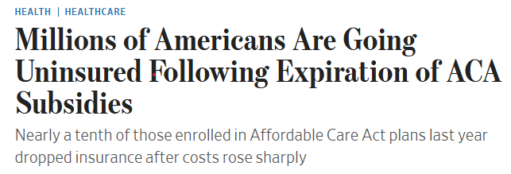
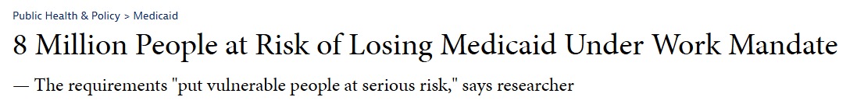

Current State of Healthcare in America
7
Notes:
Chuck

Slide 8
PeaceHealth Update
Stewardship and Reinvestment in our people and infrastructure
Ongoing adaptation and continuous evolution

Slide 9
PeaceHealth Clinical Access
Lorna Gober, MD, Chief Medical Officer, Northwest Region

Slide 10
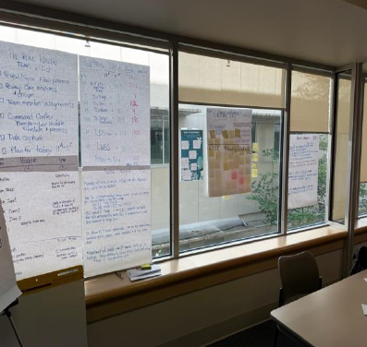
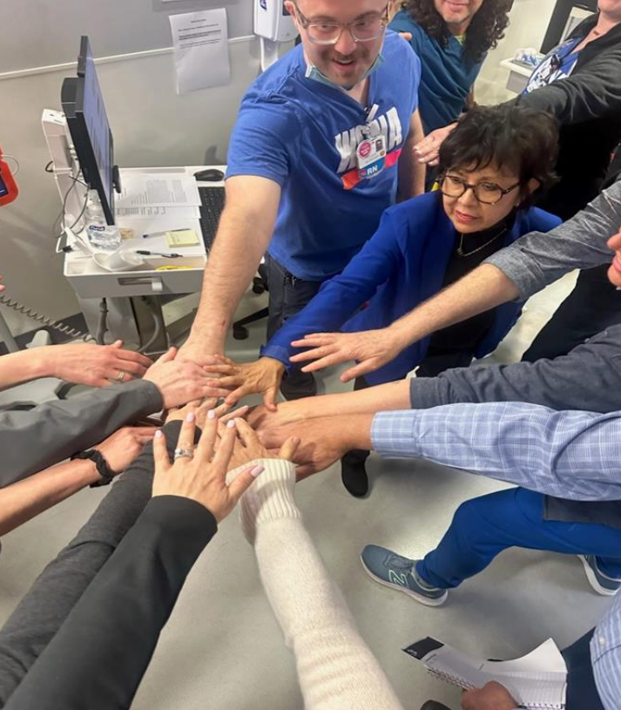
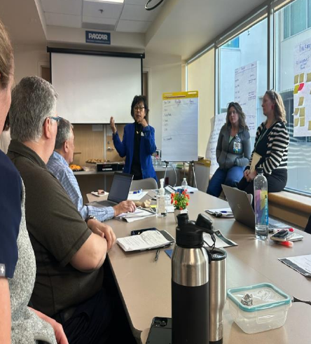
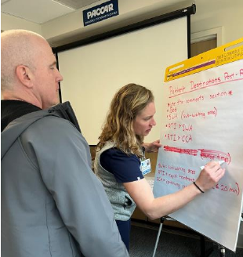
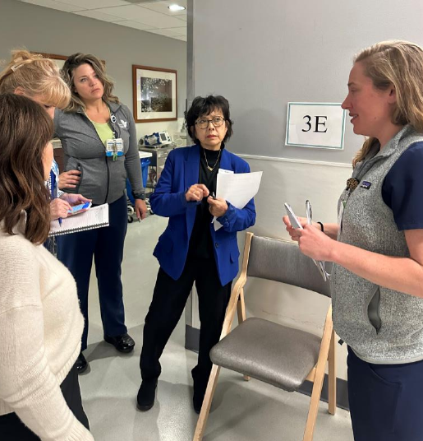
Access to Care Improvement:
Emergency Department
10
Notes:
Chuck

Slide 11
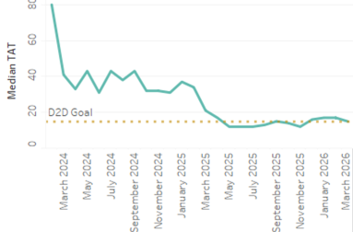
Emergency Department Progress
Door to Doctor:
March 2024 / 80+ minutes
March 2026 / 22 minutes
11
Notes:
Chuck

Slide 12
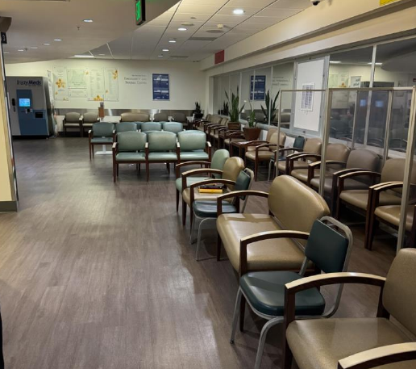
Improved Access!

Slide 13
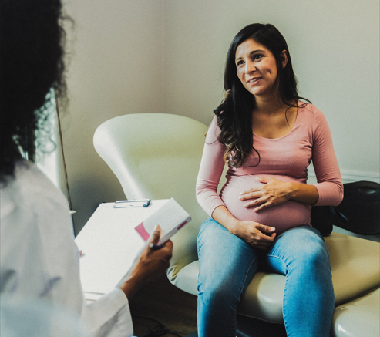
Clinic Access for our Patients

Slide 14

Better our world, drop by drop!
Blood drive April 15
Wednesday, April 15
Mobile Bus @ St. Luke’s Health Education Center
15 slots remain open
Appointments required

Slide 15
Community Partnerships
Rachel Lucy, Director of Community Health, Northwest Region

Slide 16

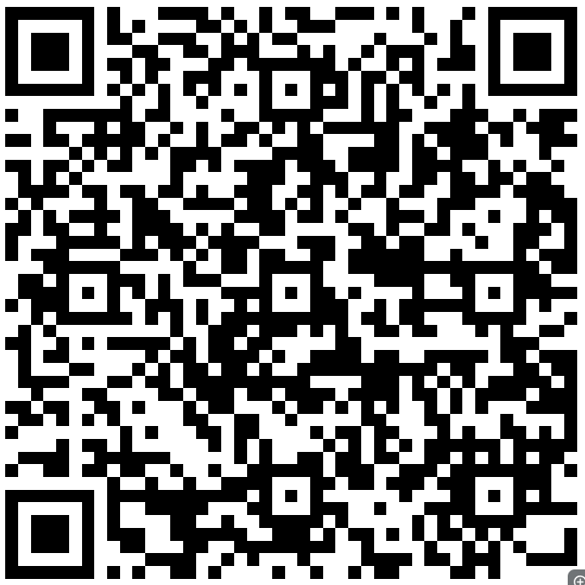

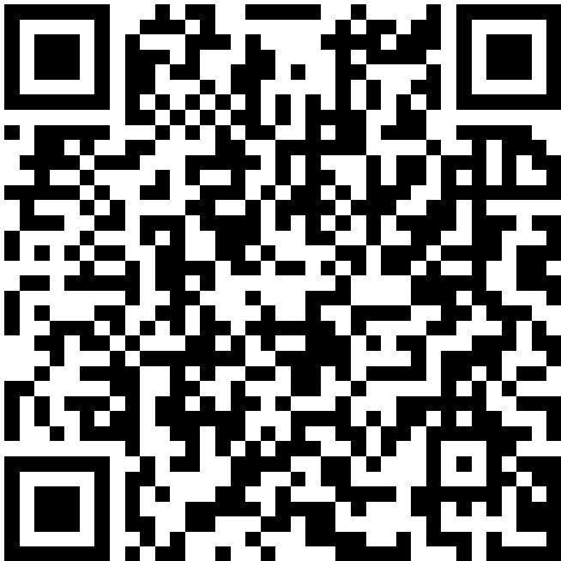
Community Collaboration
PeaceHealth collaborates with community partners and makes direct investments that improve wellness, access, quality and health justice. PeaceHealth awarded $1.3M in community benefit grants to Whatcom non-profits in 2025.
like
Community Health Improvement Plan linked here
Notes:
Chuck

Slide 17





















17
Notes:
Chuck

Slide 18
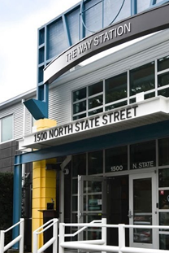
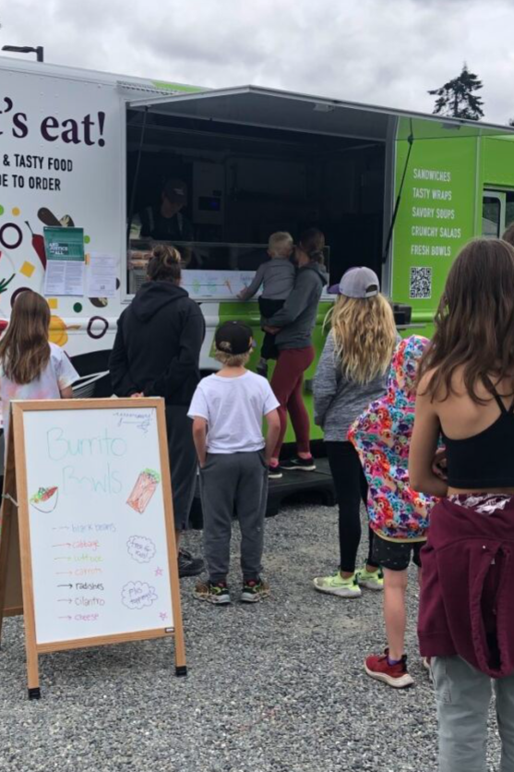
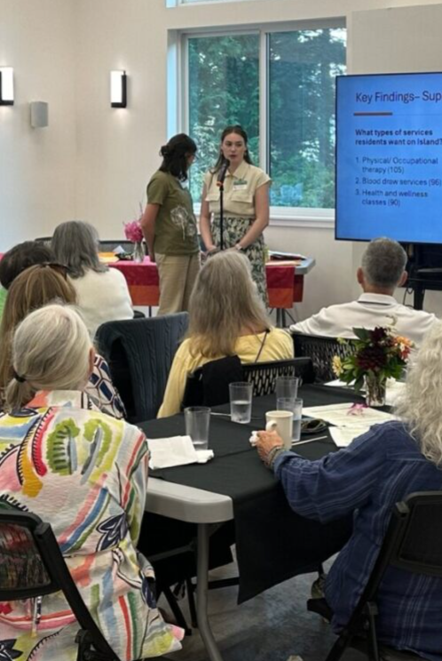

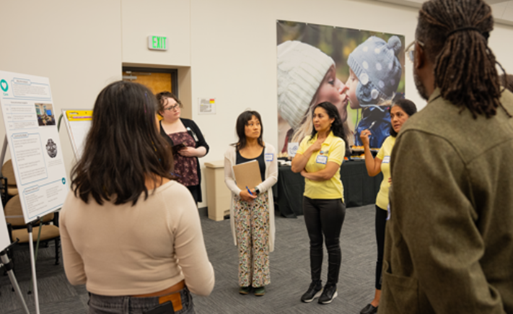

Slide 19
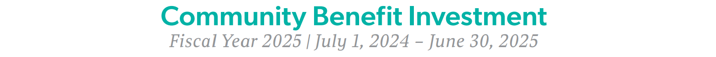
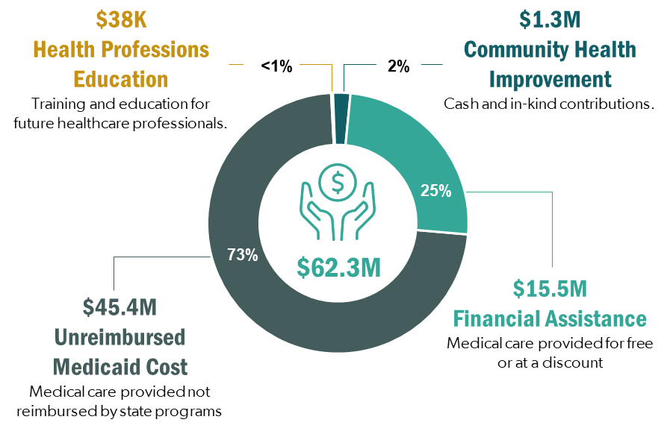
Whatcom Community
St. Joseph Medical Center

Slide 20
Construction Update
Kim Lain, Director of Planning, Design & Construction

Slide 21
Construction Update: Key Milestones
Key Milestones in the past six months –
Clearing and leveling of the site for the Peter Paulsen Pavilion
Earthwork to stabilize soil
Key infrastructure upgrades to the Central Utility Plant to support the Pavilion including underground utilities installation for water and power
Temporary roadway and ramp installation to access construction site
Squalicum Parkway improvements complete to provide bike lanes, sidewalks and crosswalks
Landscaping improvements including tree planting along Squalicum Parkway
Notes:
Chuck

Slide 22
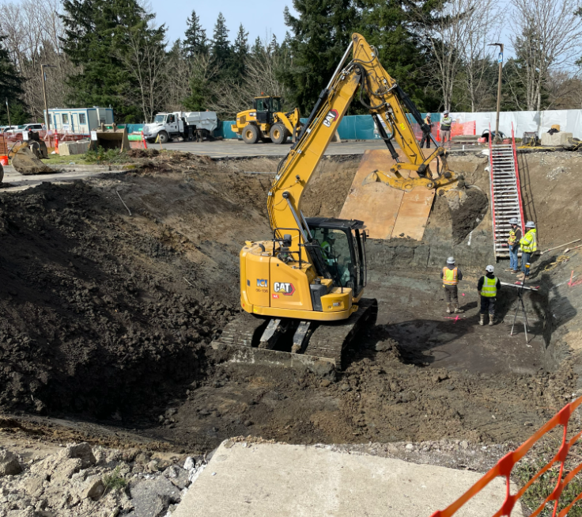
Peter Paulsen Pavilion
Site Preparation for Stormwater Management System

Slide 23
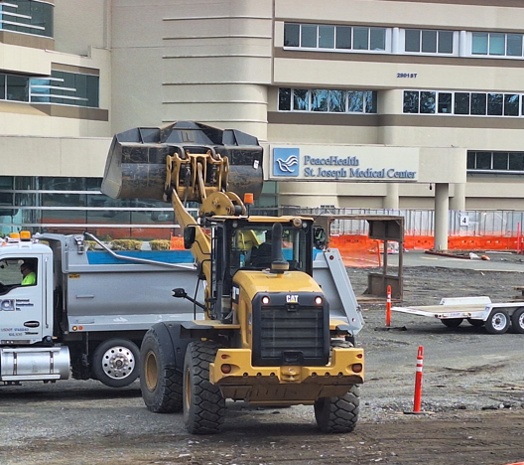
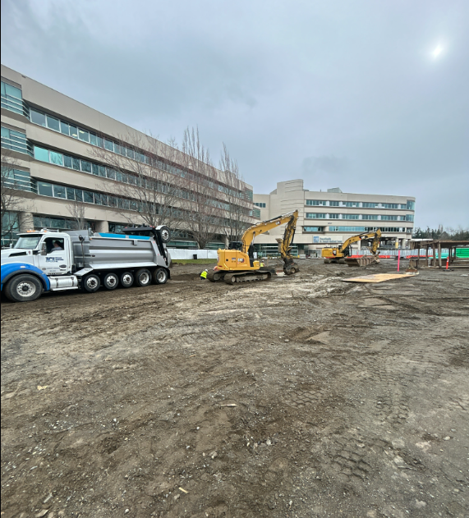
Peter Paulsen Pavilion
Site clearing and leveling to prepare for the Peter Paulsen Pavilion

Slide 24
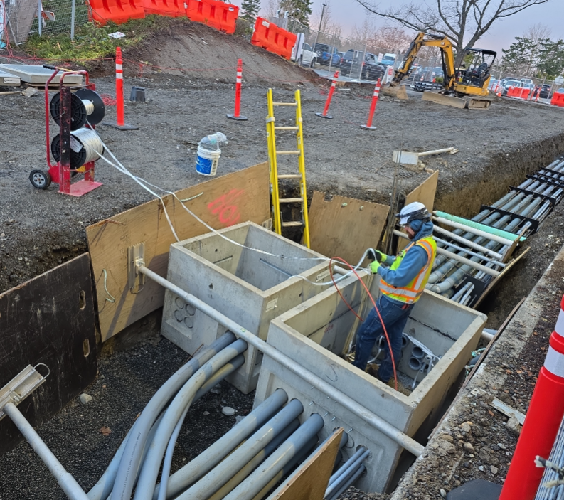
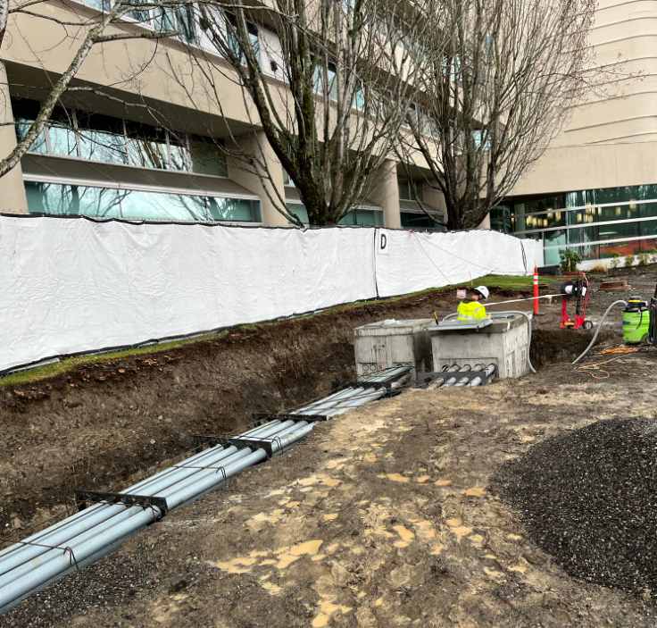
Peter Paulsen Pavilion
Peter Paulsen Pavilion and Central Utility Plant Upgrades – Piping installation

Slide 25
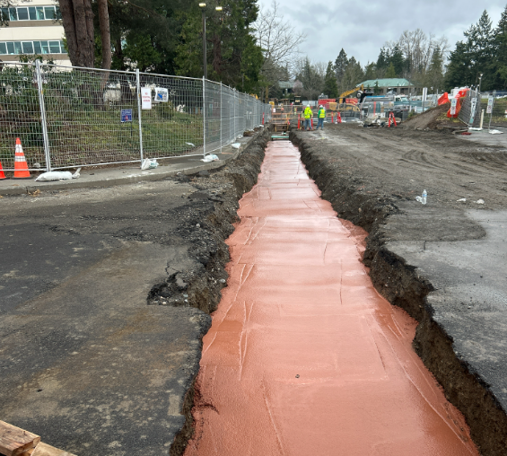
Peter Paulsen Pavilion
Red concrete is placed over piping to identify underground utility locations

Slide 26
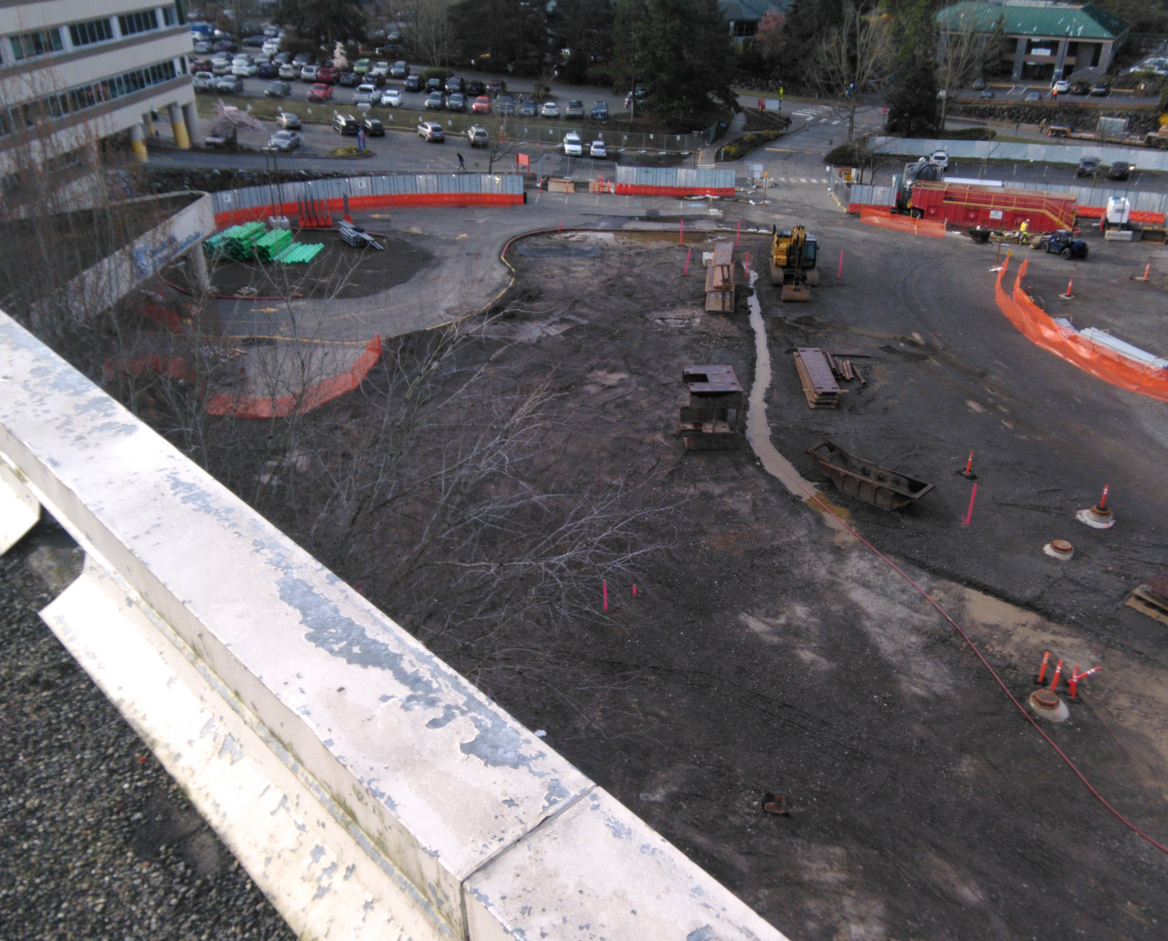
Peter Paulsen Pavilion
Overall site review of recent construction progress in March 2026

Slide 27
Construction Update: Looking Ahead
Anticipated work for the next six months –
Demolition of the old hospital main entrance
Site preparation and clearing
Stormwater management system installation
Relocation and activation of water piping to serve the Peter Paulsen Pavilion
Foundation installation for the Pavilion
Steel erection for the Pavilion structure
Notes:
Chuck

Slide 28
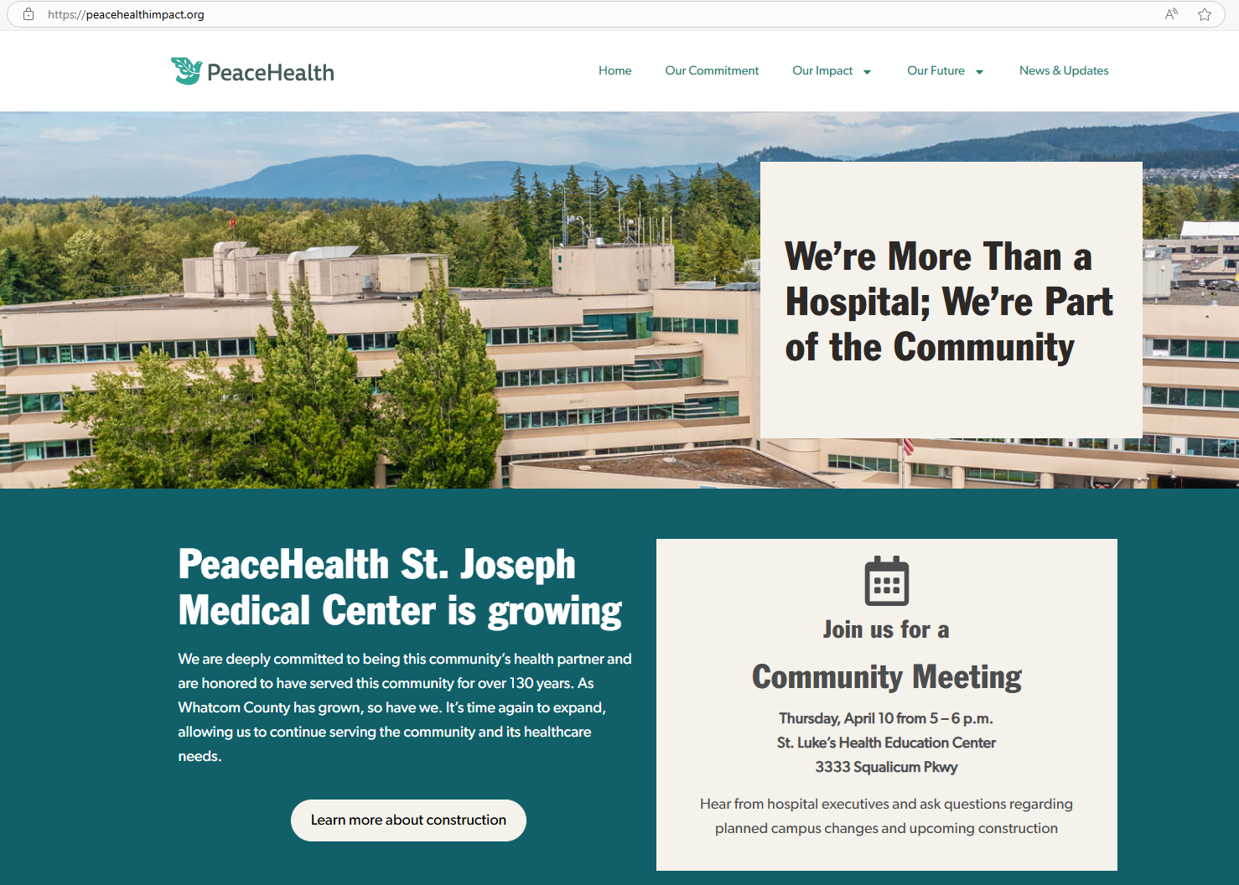
Construction Communication: Staying in Touch
PeaceHealth Microsite:
Weekly updates
PeaceHealth Impact - Whatcom
https://peacehealthimpact.org/
Notes:
Chuck

Slide 29
Questions?
Q&A
Hilary Wilkinson, Facilitator
Notes:
Chuck

Slide 30
Appendix
Notes:
Chuck

Slide 31
Airlift Northwest
Bellingham Arrival / Departure Flight Procedures
Procedures for arrival & departure
St. Joseph’s Hospital Bellingham
Notes:
Chuck

Slide 32
Airlift Northwest
Bellingham Arrival / Departure Flight Procedures
No Fly Area (See following slides)
Avoid Area - Child Care Center
Maintain 1000 feet Above Ground Level
until in a position for a normal approach.
Maneuvering at lower altitudes for landing.
Notes:
Chuck

Slide 33
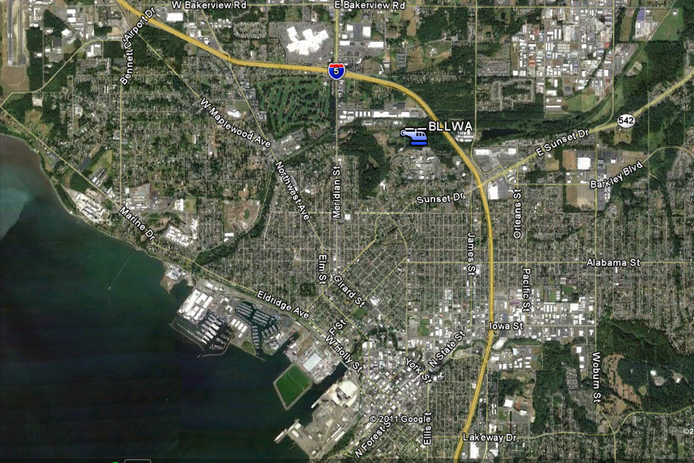
Bellingham Arrival / Departure Procedures
Bellis Fair
Mall
Maneuver
to land
Maneuver
to land
1000’
AGL
NO
FLY
ICE
Sign
1000’
AGL

Slide 34
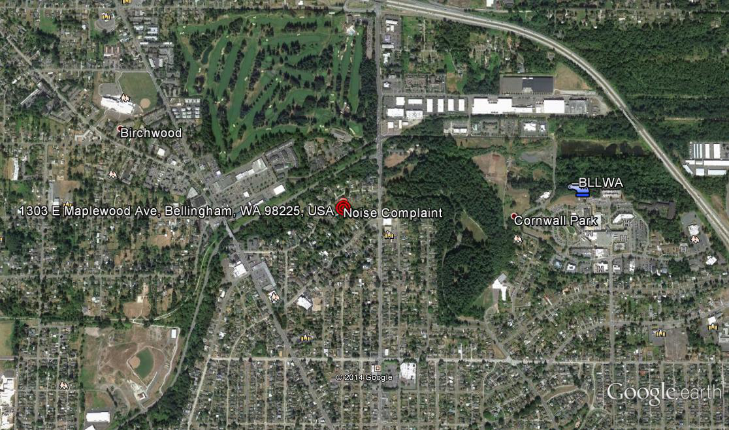
Bellingham Arrival / Departure Procedures
Maneuver
to land
Maneuver
to land
1000’
AGL
Noise complaint address
ICE
Sign
NO
FLY

Slide 35
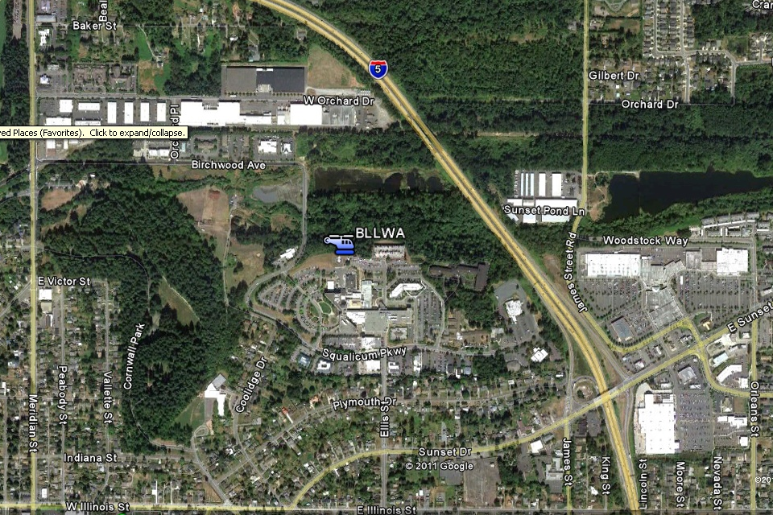
Bellingham Arrival / Departure Procedures
Maneuver
to land
Maneuver
to land
NO
FLY

Slide 36
PeaceHealth Clinical Update
Lorna Gober, MD, Chief Medical Officer, Northwest Region
Improved Emergency Department Access with Peter Paulsen Pavilion:
New build will represent total of 65 Emergency Department rooms plus 4 triage rooms
This will allow us to not only accommodate current average volume of 200 patients per day – 72,000 visits per year -- it will also allow us to meet projected growth over next 25 – 30 years as each room represents average of 2,000 visits per year, giving us capacity for 130,000 visits.
36
36
Notes:
Chuck

Slide 37
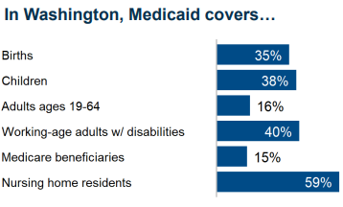
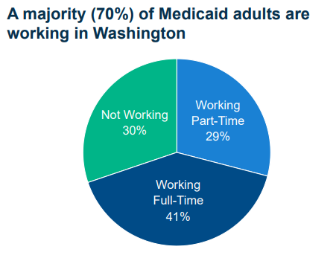
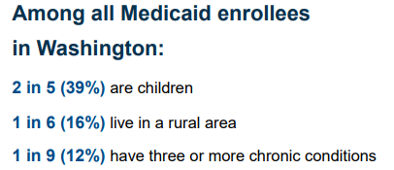
Medicaid Matters
Access to Health Insurance Improves Population Health
Group | Whatcom 240,500 | WA State 8,115,100
% Total Pop on Medicaid | 23% | 23.7%
Children | 40% (22,434) | 44%
Adults 19-64 | 51% (28,107) | 47%
Adults 65+ | 8.8% (4,900) | 8.8%
Uninsured | 6.9% | 6.4%
2025 total clients | 55,501 | 1,931,250
1 in 5 Americans are enrolled in Medicaid,
including 2 million Washingtonians (1 in 4).
Notes:
Without Medicaid coverage, the financial strain, worry and stress can prohibit them from seeking the right care at the right time. We know fear keeps people away from preventative care too, and wow how awful that impact is. We saw this post covid

